Slide 1

Revolutionizing Marine Assessment Services with NLP
Marine surveyors across the globe face unique challenges in obtaining clarifications quickly. Our client wants to reduce the burden and make the process faster through the power of NLP. Dive into our data science approach.
SR
by Smitraj Raut

Slide 2

Problem Statement: Slow Clarifications
1
Issues
2
Challenges
Marine surveyors need to quickly clarify assessments across different geographies and time zones.
Current solutions can be time-consuming and offer limited accessibility.
3
Solution
Our NLP solution can reduce the burden on SMEs and streamline the clarification process.

Slide 3
Knowledge Base Creation and Intent Recognition
Knowledge Base Creation
Intent Recognition
Machine Learning
We create custom data dictionaries to capture all marine lingo and phrases.
We build a strong neural network to understand the user's intent and the appropriate response.
We train machine learning models to increase the system's accuracy and precision.

Slide 4
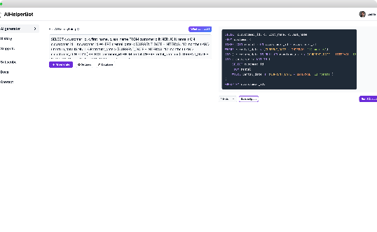
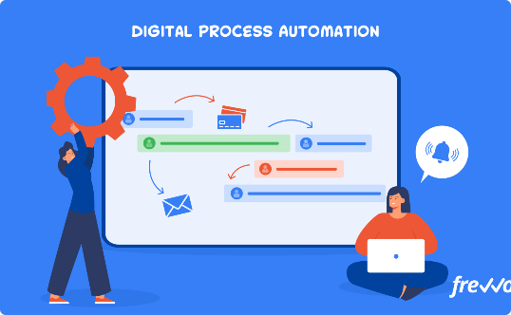
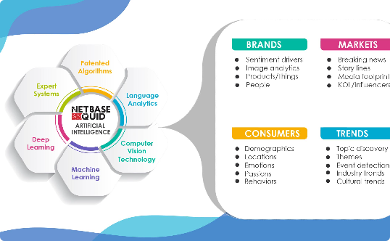
Design Approach for NLP Solution
Query Bot
Process Automation
NLP
We design a query bot to interact with surveyors and gather intel. This bot understands user intent, captures and unloads appropriate information.
Through machine learning models combined with intelligent automation and AI, we automate and expedite marine assessments.
Our NLP solution understands marine jargon and can accurately interpret user requests with an appropriate response.

Slide 5
Multilingual and Geographical Considerations and Time Zone Adaptation
1
Multilingual Support
Our NLP solution supports multiple languages to assist marine professionals worldwide.
2
Geographical Considerations
Our solution is tailored to specific geographical regions, capturing specific marine terms and phrases.
3
Time Zone Adaptation
Our system adapts to all time zones, ensuring flexibility for our users.

Slide 6

Continuous Learning and Improvement
1
Data Analysis
2
Feedback Mechanism
3
Continuous Improvement
Our system will continuously analyse data for further improvements to the machine learning models.
The system will enable users to provide feedback to improve the user experience and the effectiveness of the tool.
We'll continuously improve and enhance our NLP system to provide the best possible service to marine surveyors globally.

Slide 7
Deployment and Integration and Security and Privacy
Deployment and Integration
Security
Privacy
We employ state-of-the-art security measures to safeguard user data, ensuring GDPR compliance and industry standards.
We respect user privacy and ensure their data is not misused or used for purposes other than marine assessments.
We integrate our solution with your existing systems, ensuring ease of use for users.

Slide 8

Conclusion: Revolutionizing Marine Assessments with NLP
Our revolutionary solution empowers marine surveyors to obtain clarifications quickly, saving time and increasing accuracy. We believe that our NLP system will take marine assessments to the next level and revolutionize the industry for the better.

